Slide 1


Department of Computer Science & Engineering
Technical Seminar on
“IoT Security Risk Management Model for Secured Practice in Healthcare Environment”
UNDER THE GUIDANCE OF
Mrs. Geetha Pawar
Asst. Professor
Dept. of Computer Science
Presented By
SREELEKHA PASIKANTI (1RG16CS096)

Slide 2
CONTENTS
Abstract
Introduction
State of the art
Architecture
Application
Future Scope
Conclusion
References

Slide 3
ABSTRACT
The emerging of Internet of Things (IoT) technologies for unified and interconnected medical devices and sensors has changed the scenario in the healthcare industry. However, with the ‘openness’ of the distributed environment and medical devices, IoT will be the point of a breach where attackers are able to identify vulnerabilities and subsequently launch their attacks. This becomes high risk to the healthcare environment which may cause a big impact on its security measure. To address this issue, this study proposes an IoT Security Risk Management Model for Secured Practice in Healthcare Environment. A model was formulated which consist of three parts, the Healthcare IoT Risk Management, the Hospital Performance Indicator for Accountability (HPIA) and the implementation phases. As a result, a priori model was successfully developed and yet to be validated by the case study participants in the next stage.

Slide 4
INTRODUCTION
Recently various IoT applications are being developed based on healthcare platform. One of the purposes of developing IoT devices is to help the healthcare personnel in diagnostic activities of patients.
Despite the recent advancement of IoT in healthcare, there is an alarming concern on the security and privacy aspect of the health data shared through these IoT devices. This also caused a healthcare data at risk, which means immediate action should be taken to ensure patients data are not being jeopardized while medical practitioners can still leverage on the IoT solutions in assisting their daily operations.
For this reason, this paper examines the IoT security, privacy and risk factors in the healthcare sector and the practitioners in order to provide a secured Healthcare IoT environment with compliance to the existing quality performance indicators.

Slide 5
STATE OF THE ART
This study adopted the Control Objectives for Information and related Technology (COBIT5) due to its ability to synergize with another standard in a seamless way. COBIT5 focus on the enterprise level and the solution is not just limited to the IT domain.
The model consists of three parts, which are Healthcare IoT Risk Management, HPIA alignment and COBIT5 implementation phases.
The first part of the model is the COBIT IoT Risk Management which is formulated based on the IoT risk category such as 1) data and application, 2) user change management, 3) security and privacy, 4) physical environment, 5) 3rd party supplier and vendor, and 6) infrastructure.
The model then incorporates the HPIA categories which are Internal business process, Customer focus, Employee Satisfaction, Learning and growth, Financial and Office Management and finally Environmental Support. This is in line with the healthcare quality KPI as explained by the case study participants HPIA is mandatory rules to be followed.
The model then proposes seven phases of implementation originated from COBIT5 to guide the implementation process of IoT from the beginning.

Slide 6
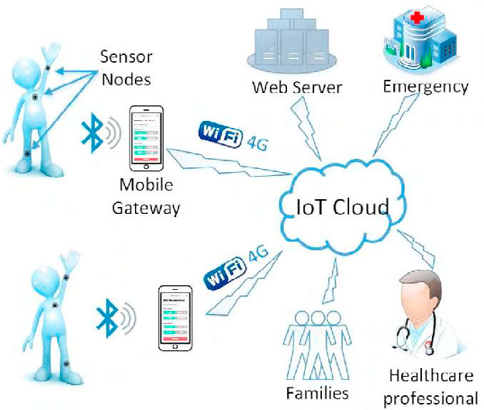
ARCHITECTURE
Wireless sensor network with IoT connected healthcare platform

Slide 7
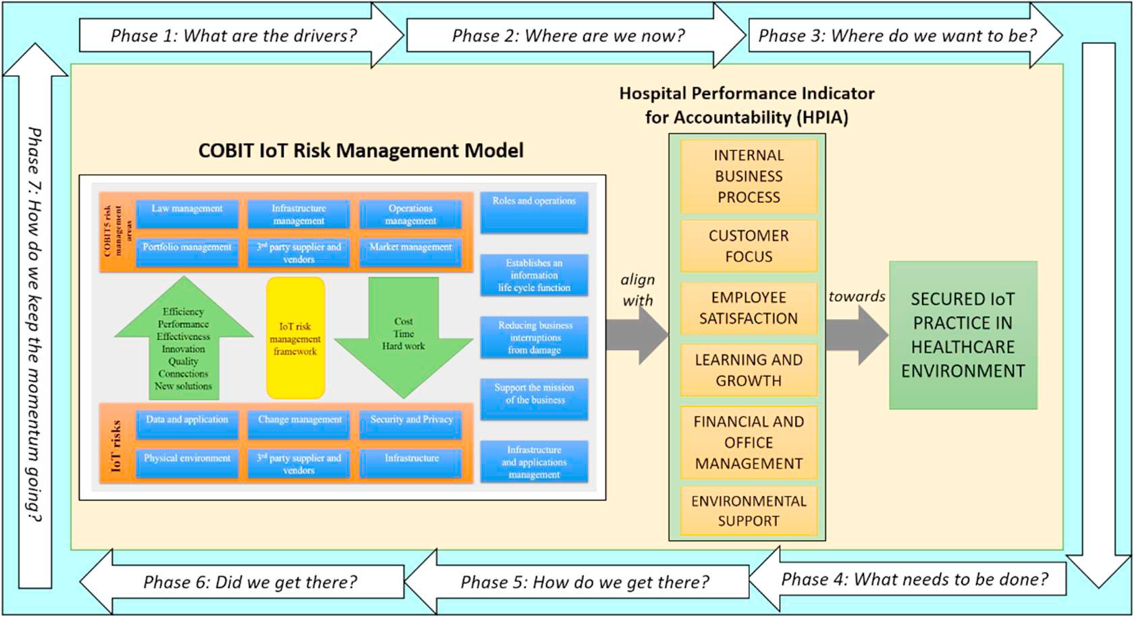
System architecture model of IoT security risk management for healthcare practice

Slide 8
APPLICATIONS
This model can be applied in the healthcare environment which is exposed to numerous risk factors based on IoT.
Some of the IOT risk factors in the healthcare environment are as follows:
Data and application - Manual data feed
User and Change Management
- Loss of caring for patient caregivers
- Non-acceptance of technology medical practitioner
Security and Privacy
- Loss of data privacy
- Hijacked and modified data
- Location privacy
- Genuine authentication on medical/clinical procedure - The attack on Server Security

Slide 9
FUTURE SCOPE
For future work, this model will be evaluated by the IoT experts in on the relevancy of the proposed components as well as the feasibility and usability evaluation which will be conducted by the healthcare practitioners.

Slide 10
CONCLUSION
The objective of healthcare IoT which are to increase access to care, upsurge the quality of the care and yet reduce the cost of care. This is attainable with the successful and secured implementation of IoT Security Risk Management Model for Healthcare Practice.
COBIT 5 shall provide a standard accepted principles, practices, tools and models to help increase the trust and value from all healthcare practitioners.
The higher IoT adoption level by doctors and consultants, awareness among healthcare community in the institution and proper supporting IT infrastructure become contributing factors of successful or swift and smooth adoption in cloud computing for the healthcare sector.

Slide 11
REFERENCES
Huraizah Zakaria, Nur Azaliah Abu Bakar, Noor Hafizah Hassan, Suraya Yaacob (2019) “IOT Security Risk Management Model for Secured Practice in Healthcare Environment.” The Fifth Information Systems International Conference
Bevan, G., A. Evans A, and S. Nuti. (2019) “Reputations Count: Why Benchmarking Performance is Improving Health Care Across the World.” Health Economics, Policy and Law 14: 141-61.
Cheon, O., M. Song, A.M. Mccrea, and K.J. Meier. (2019) “Health Care in America: The Relationship Between Subjective and Objective Assessments of Hospitals.” International Public Management Journal. pp. 1-27.
HKL. (2016) “Hospital Kuala Lumpur: Hospital Performance Indicator For Accountability (HPIA).” in Lumpur HK, (ed.)
Yuehong, Y., Y. Zeng, X. Chen, and Y. Fan. (2016) “The Internet of Things in Healthcare: An Overview.” Journal of Industrial Information Integration 1: 3-13.
Chakrabarty, A., S. Zavitsanou, T. Sowrirajan, F.J. Doyle III, and E. Dassau. (2019) “Getting IoT-ready: The Face of Next Generation Artificial Pancreas Systems.” The Artificial Pancreas. pp. 29-57.
West, D.M. (2016) “How 5G Technology Enables the Health Internet of Things.” Brookings Center for Technology Innovation 3: 1-20.

Slide 12
THANK YOU

